Slide 1
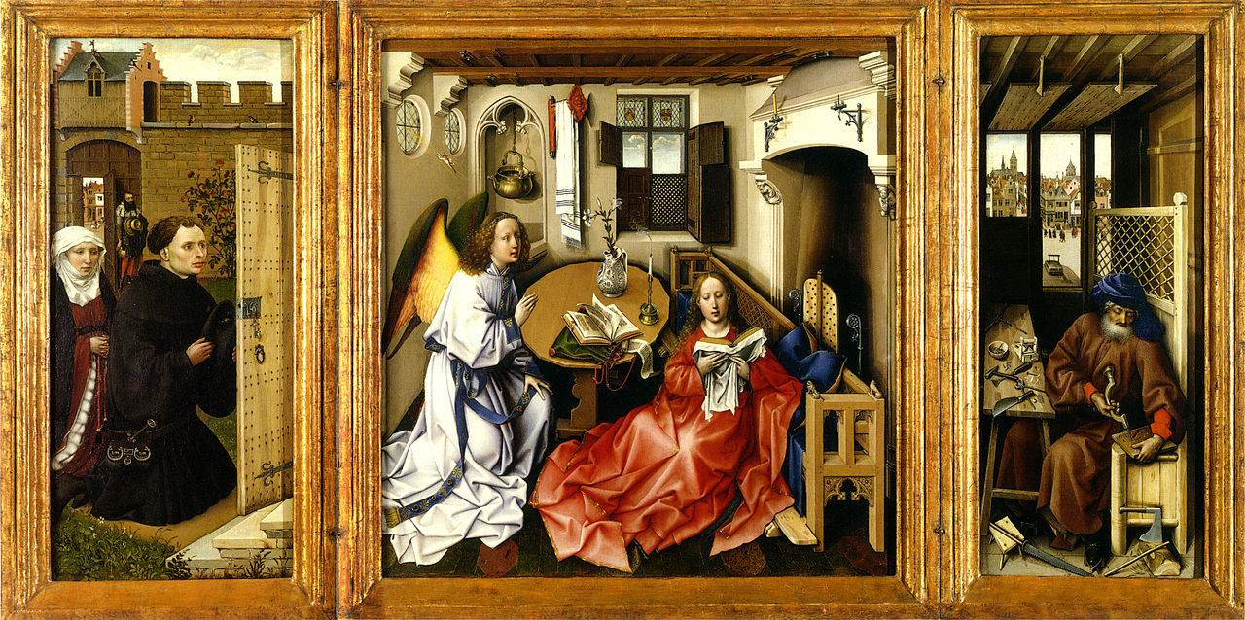

Robert Campin
(1375-1444)
Flemish and Early Netherlandish painter
Annunciation

Slide 2
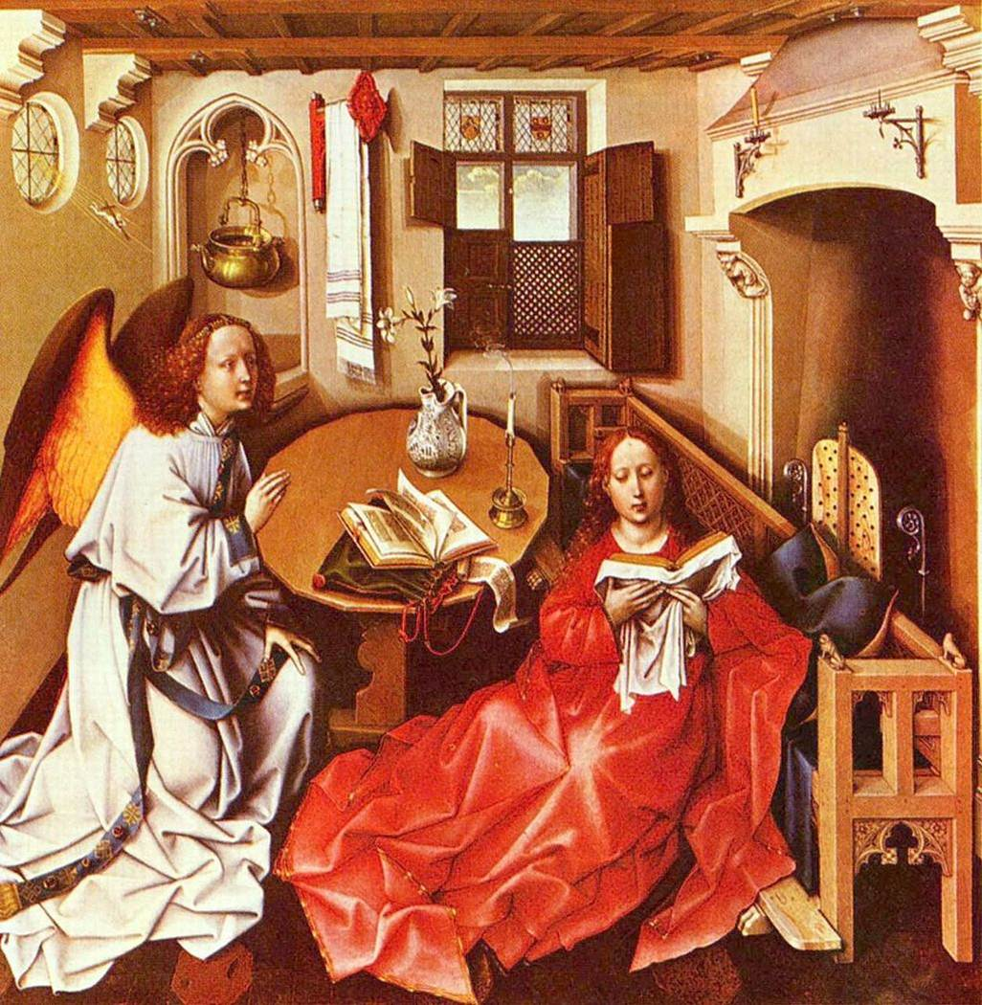
Annunciation(detail)

Slide 3
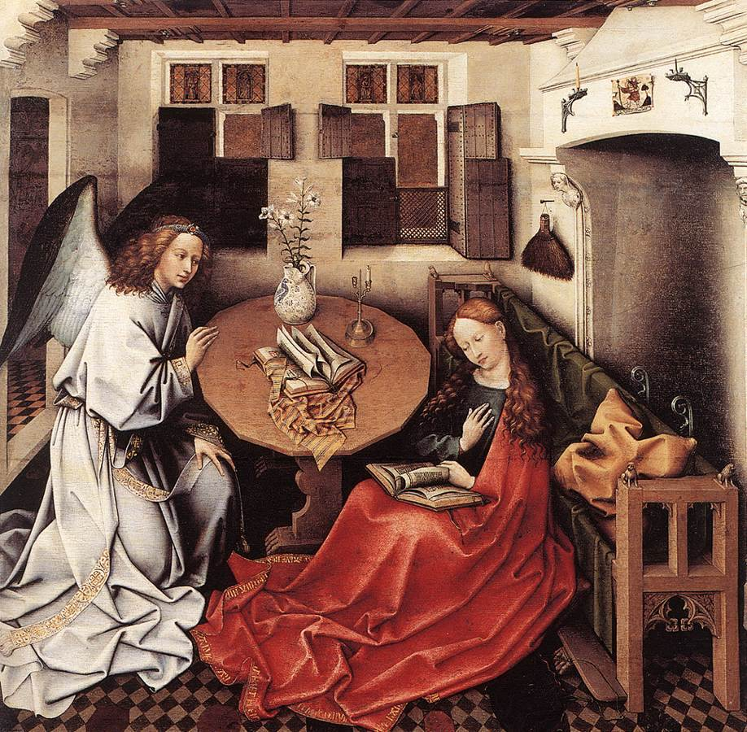
Annunciation

Slide 4
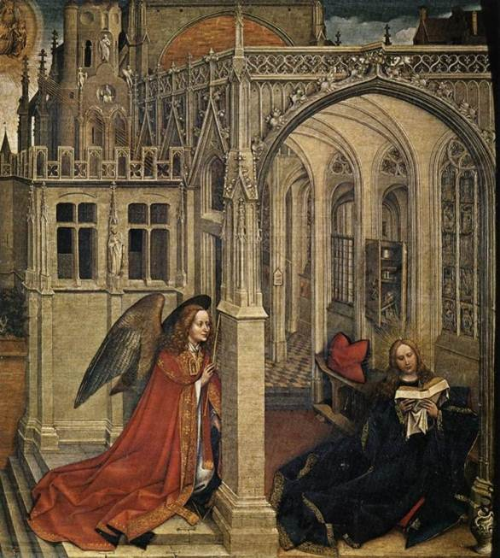
Annunciation

Slide 5
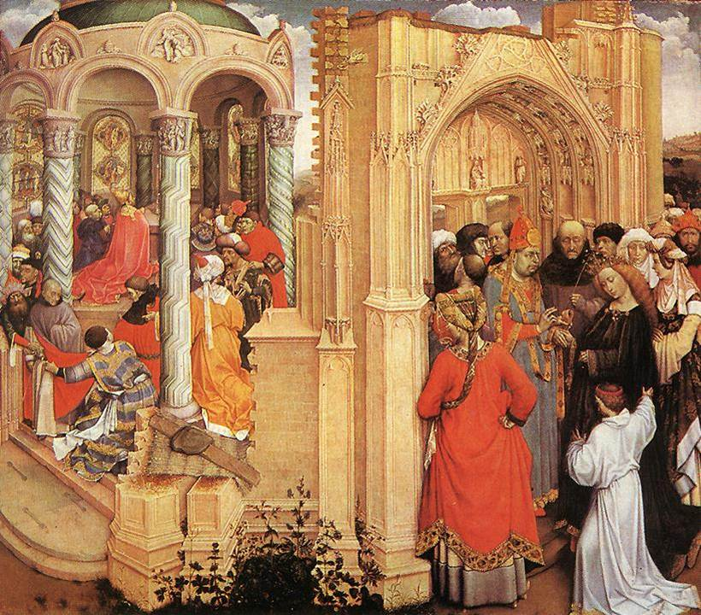
The Marriage of Mary

Slide 6
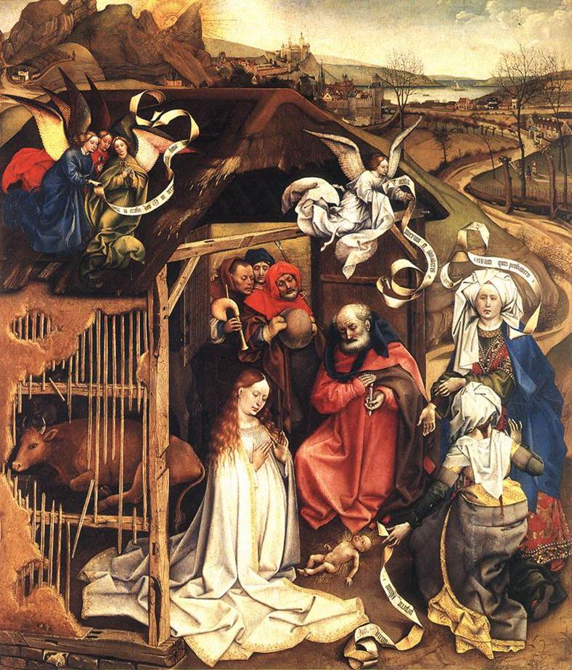
The Nativity

Slide 7
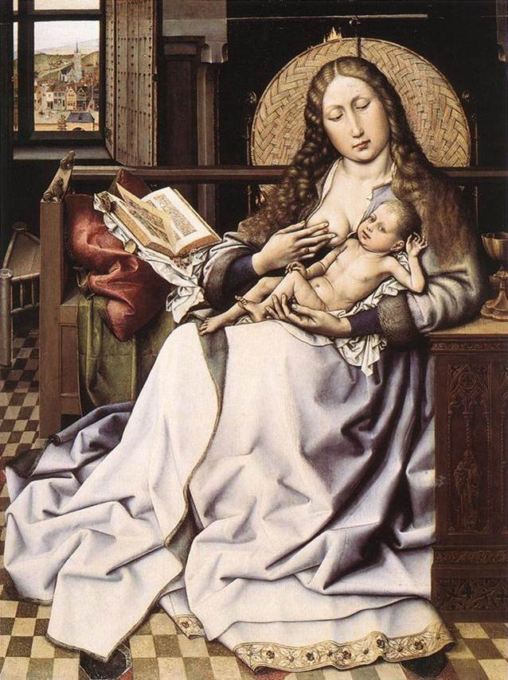
The Virgin and Child

Slide 8
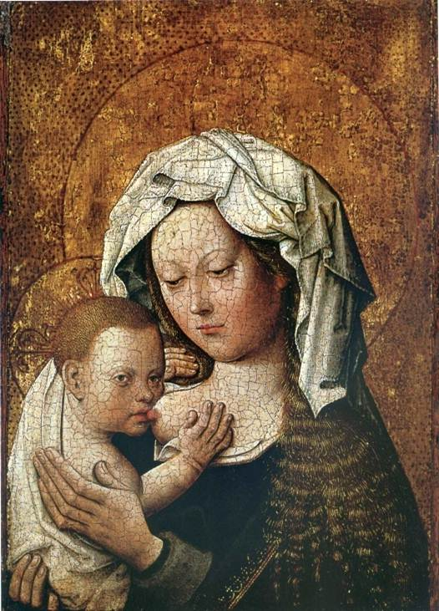
Madonna and Child

Slide 9
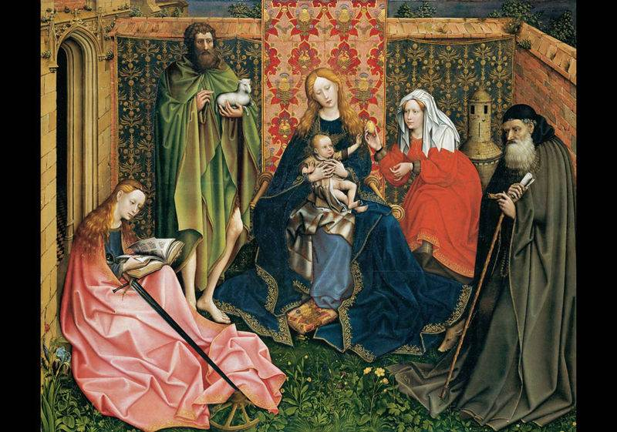
Madonna and Child with Saints

Slide 10
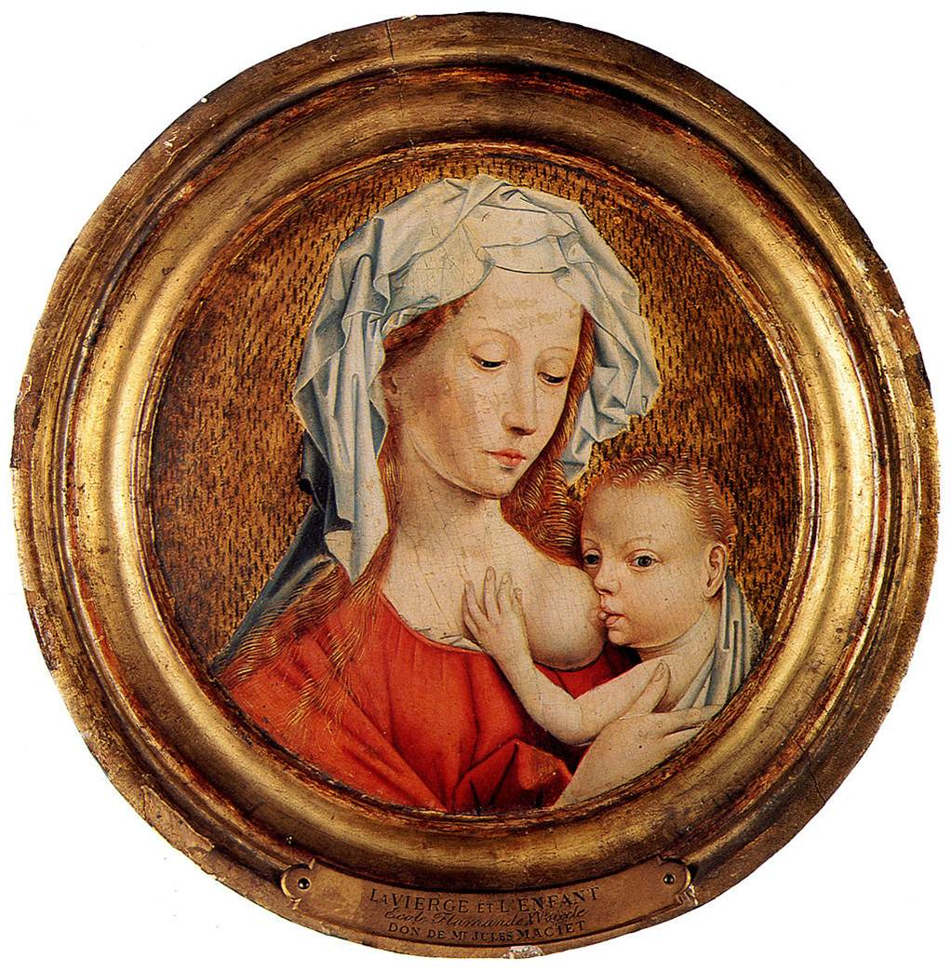
Madonna and child

Slide 11
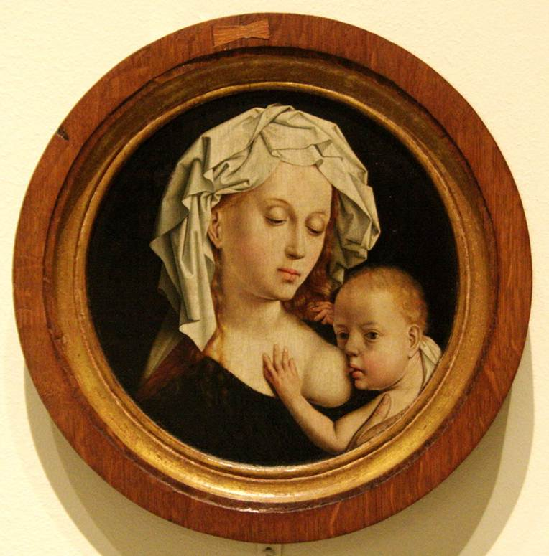
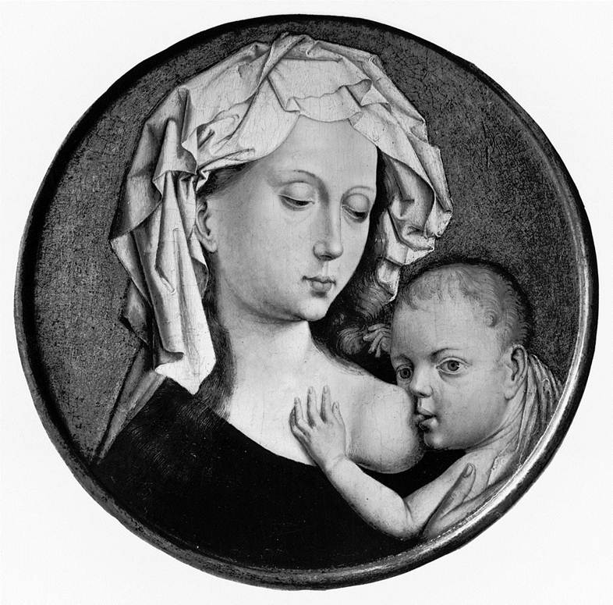
Madonna and Child

Slide 12
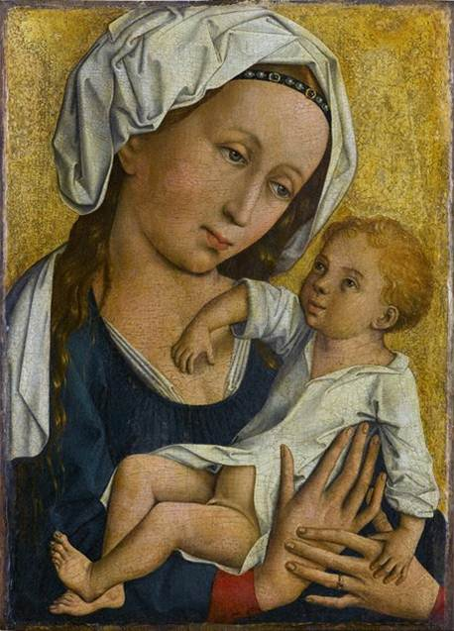
The Virgin and Child

Slide 13
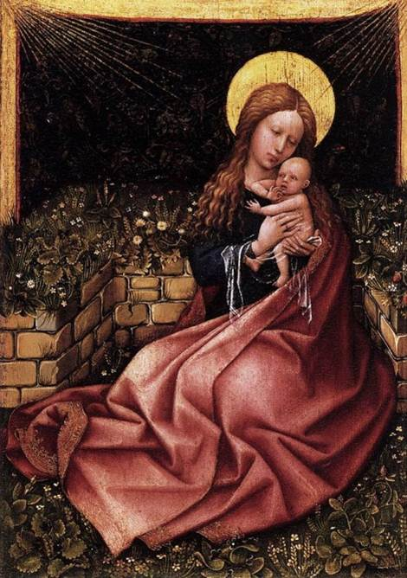
The Virgin and Child

Slide 14
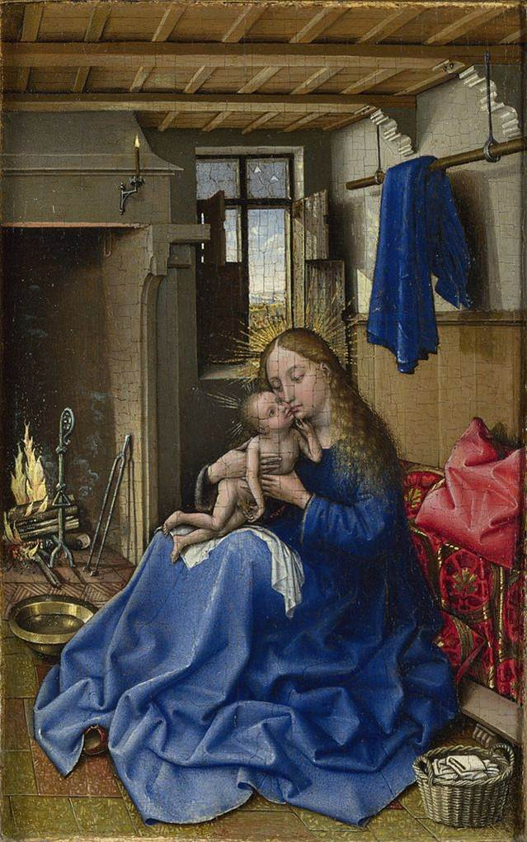
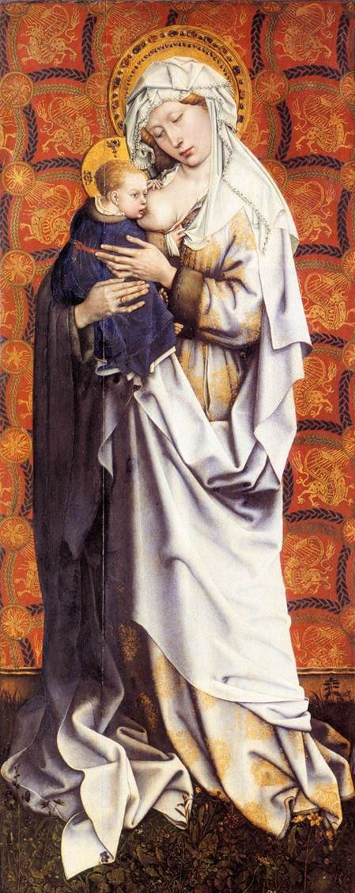
The Virgin and Child

Slide 15
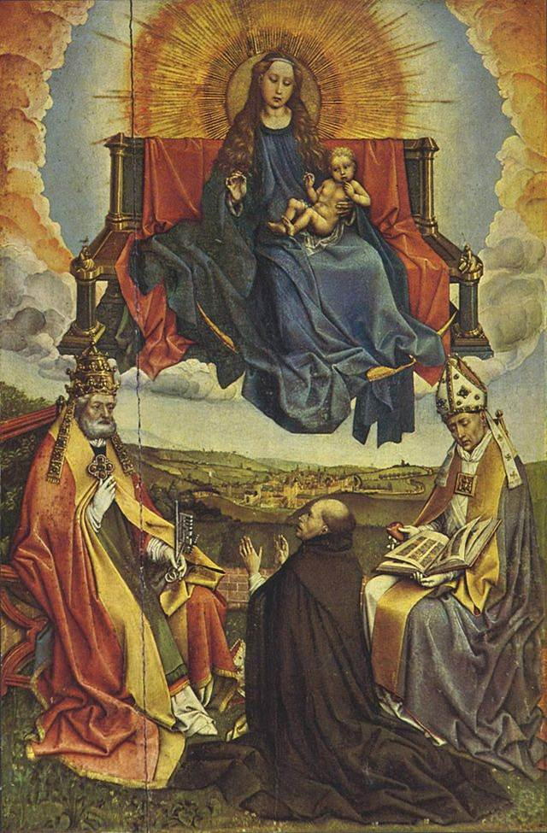
Adoration of Magi

Slide 16
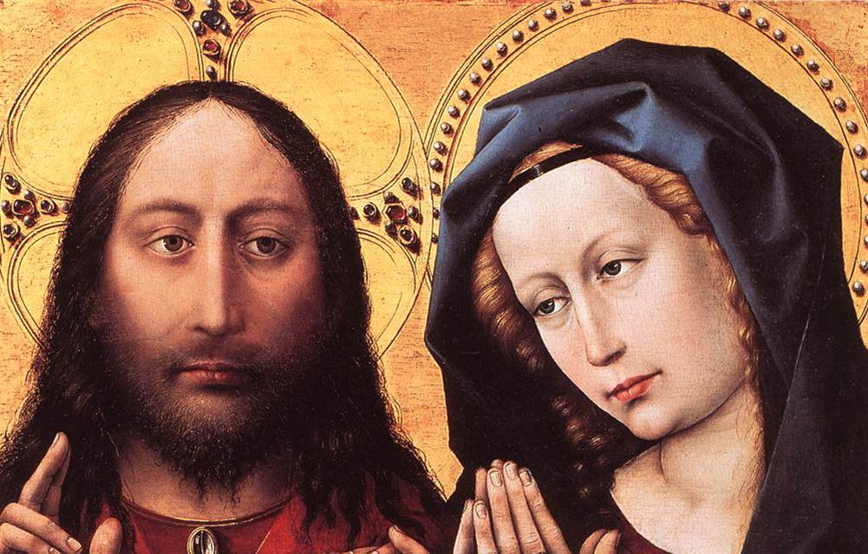
Blessing Christ and Praying Virgin

Slide 17

Life of Saint Joseph

Slide 18
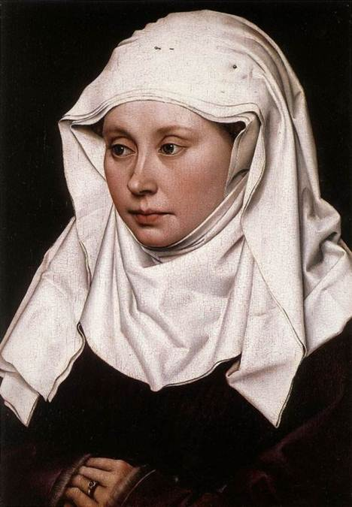
Virgin

Slide 19
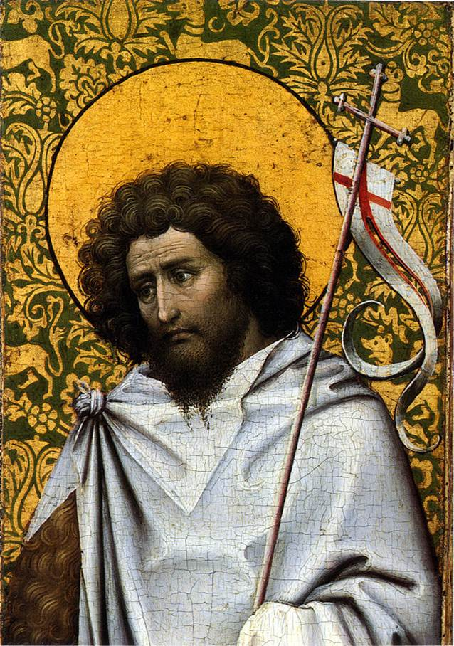
Saint John the Baptist

Slide 20
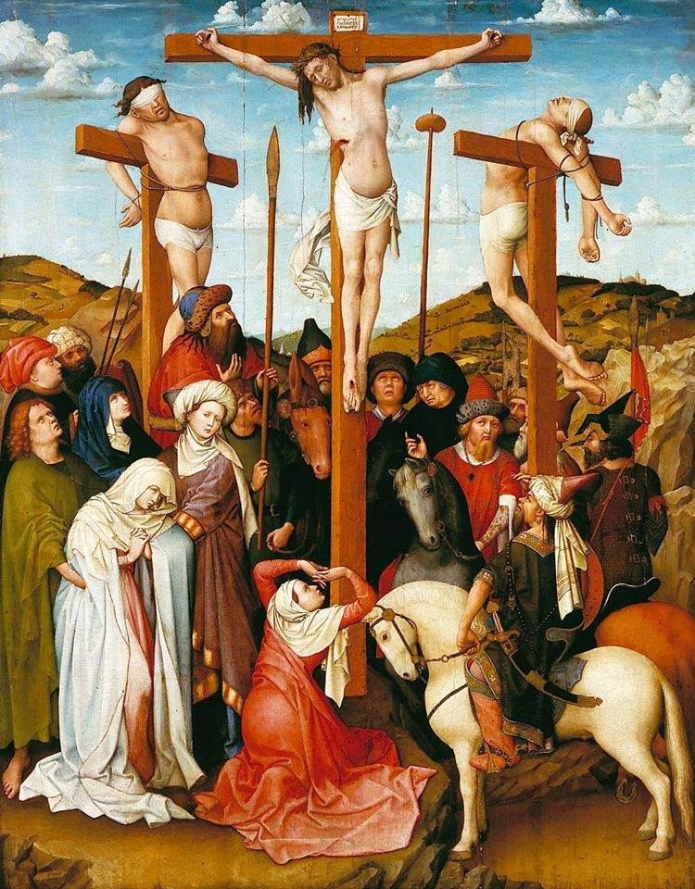
Crucifixion

Slide 21
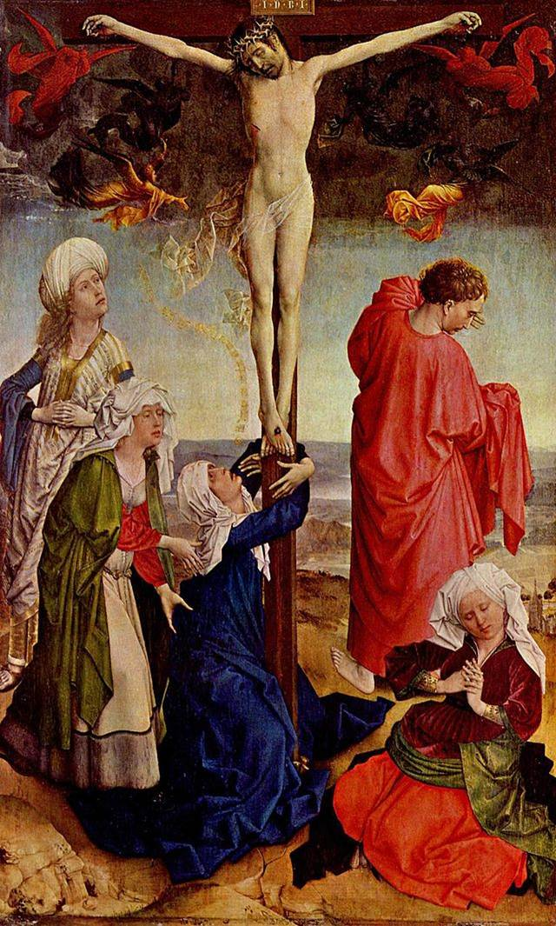
Crucifixion

Slide 22
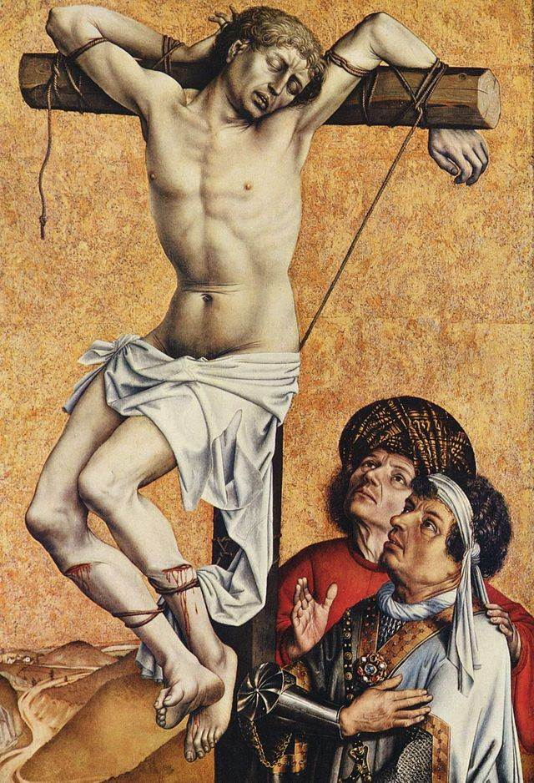
Crucifixion

Slide 23
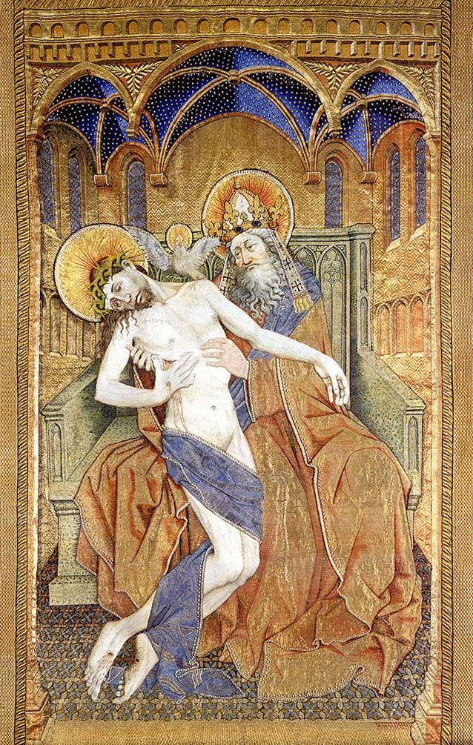
Trinity of the broken body

Slide 24
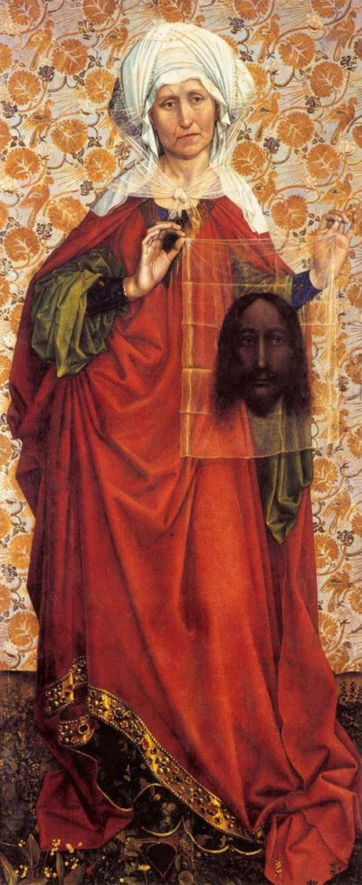
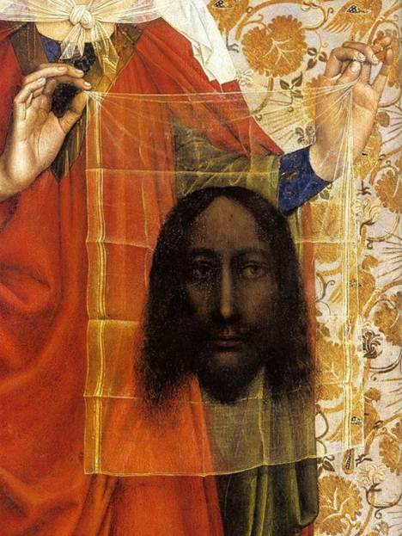
St. Veronica

Slide 25
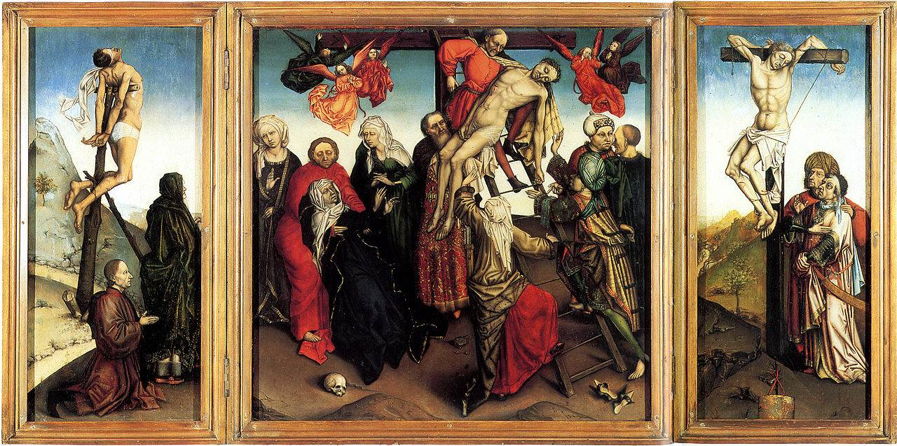
Descent from the Cross

Slide 26
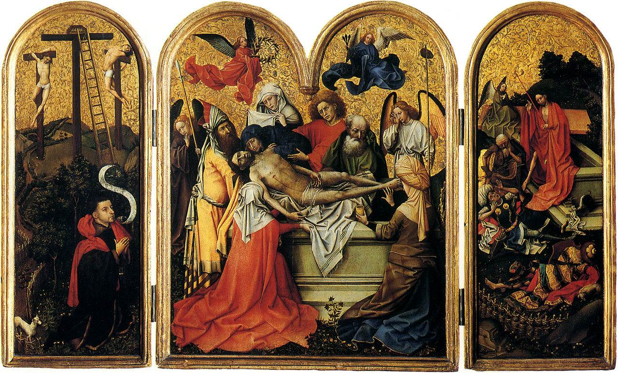
Triptych with the Entombment of Christ

Slide 27
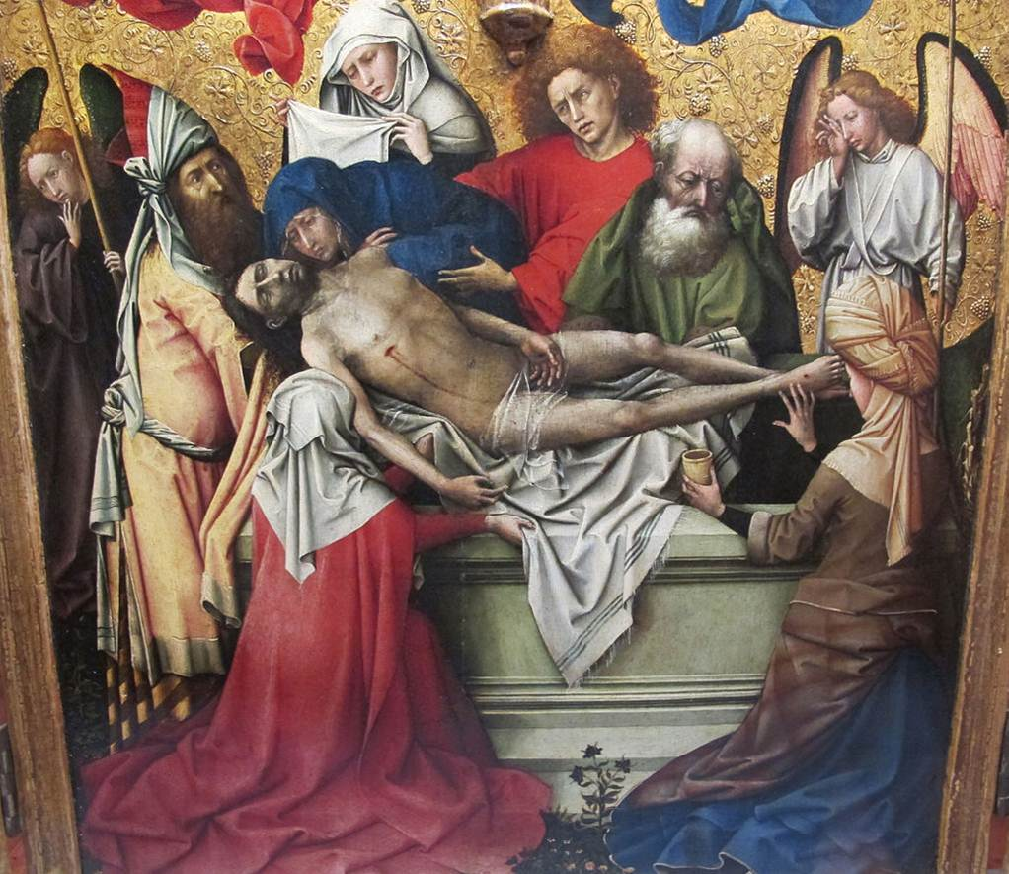
Triptych with the Entombment of Christ(Detail))

